Slide 1
Hashing
Tables
Direct address tables
Hash tables
Collision and collision resolution
Chaining

Slide 2
Introduction
Many applications require a dynamic set that supports dictionary operations.
Example: a compiler maintaining a symbol table where keys correspond to identifiers
Hash table is a good data structure for implementing dictionary operations
Although searching can take as long as a linked list implementation i.e. O(n) in worst case.

Slide 3
Introduction
With reasonable assumptions it can take O(1) time.
In practice hashing performs extremely well.
A hash table is a generalization of an ordinary array where direct addressing takes O(1) time.
When the actual keys is NOT small relative to the total number of keys, hashing is an effective alternative.
A key can be accessed using an array index, or is computed.

Slide 4
What are Tables?
Table is an abstract storage device that contains table entries
Each table entry contains a unique key k.
Each table entry may also contain some information, I, associated with its key.
A table entry is an ordered pair (K, I)

Slide 5
Direct Addressing
Suppose:
The range of keys is 0..m-1
Keys are distinct
The idea:
Set up an array T[0..m-1] in which
T[i] = x if x∈ T and key[x] = i
T[i] = NULL otherwise
This is called a direct-address table
Operations take O(1) time!

Slide 6
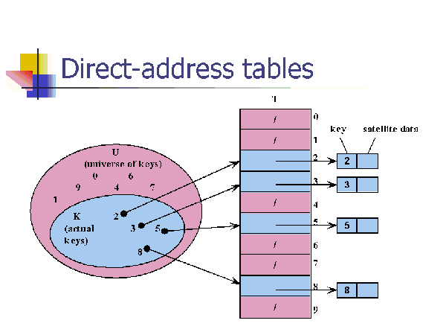
8

Slide 7
Advantages with Direct Addressing
Direct Addressing is the most efficient way to access the data since.
It takes only single step for any operation on direct address table.
It works well when the Universe U of keys is reasonable small.

Slide 8
Difficulty with Direct Addressing
When the universe U is very large…
Storing a table T of size U may be impractical, given the memory available on a typical computer.
The set K of the keys actually stored may be so small relative to U that most of the space allocated for T would be wasted.

Slide 9
Hash Tables
Definition: the ideal table data structure is merely an array of some fixed size, containing the elements.
Consist : an array and a mapping function (known as hash function)
Used for performing insertion, deletion and lookup on average in constant time.

Slide 10
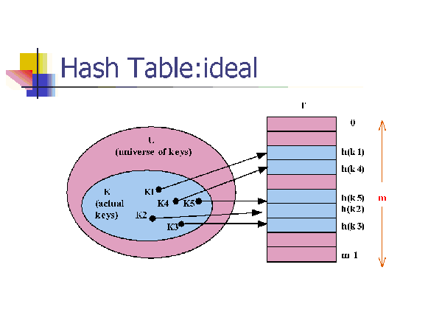
14

Slide 11
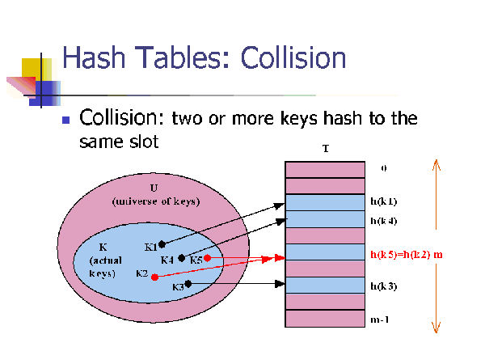
16

Slide 12
Resolving Collisions
How can we solve the problem of collisions?
Solution 1: Chaining
Solution 2: Open addressing

Slide 13
Chaining!
Put all the elements that hash to same slot in a linked list.
Worst case : All n keys hash to the same slot resulting in a linked list of length n, running time: O(n)
Best and Average time: O(1)

Slide 14
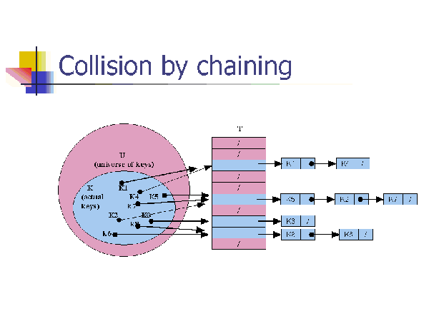
20

Slide 15
Analysis of Chaining
Assume simple uniform hashing: each key in table is equally likely to be hashed to any slot
Given n keys and m slots in the table: the load factor α = n/m = average # keys per slot
What will be the average cost of an unsuccessful search for a key?
O(1+ α)

Slide 16
What will be the average cost of a successful search?
A: O(1 + α/2) = O(1 + α)

Slide 17
Analysis of Chaining Continued
So the cost of searching = O(1 + α)
If the number of keys n is proportional to the number of slots in the table, what is α?
A: α = O(1)
In other words, we can make the expected cost of searching constant if we make α constant

Slide 18
Hash Tables
Nature of keys
Hash functions
Division method
Multiplication method
Open Addressing (Linear and Quadratic probing, Double hashing)

Slide 19
Nature of keys
Most hash functions assume that universe of keys is the set N = {0, 1, 2,…} of natural numbers
If keys are not N, ways to be found to interpret them as N
A character key can be interpreted as an integer expressed in suitable Radix notation.

Slide 20
Nature of keys
Example: The identifier pt might be interpreted as a pair of decimal integers (112, 116) as p = 112 and t = 116 in ASCII notation. What is the problem?
Using a product/addition of ASCII codes is indifferent to the order of characters
Solution: Using 128-radix notation this becomes (112.128) + 116 = 14,452

Slide 21
What is a Hash function?
A hash function is a mapping between a set of input values (Keys) and a set of integers, known as hash values.
Hash
function
Keys
Hash values

Slide 22
The properties of a good hash function
Rule1: The hash value is fully determined by the data being hashed.
Rule2: The hash function uses all the input data.
Rule3: The hash function uniformly distributes the data across the entire set of possible hash values.
Rule4: The hash function generates very different hash values for similar strings.

Slide 23
An example of a hash function
int hash(char *str, int table_size)
{
int sum=0;
//sum up all the characters in the string
for(;*str; str++) sum+=*str
//return sum mod table_size
return sum%table_size;
}

Slide 24
Analysis of example
Rule1: Satisfies, the hash value is fully determined by the data being hashed, the hash value is just the sum of all input characters.
Rule2: Satisfies, Every character is summed.

Slide 25
Analysis of example (contd.)
Rule3: Breaks, from looking at it, it is not obvious that it doesn’t uniformly distribute the strings, but if you were to analyze this function for larger input string, you will see certain statistical properties which are bad for a hash function.
Rule4: Breaks, hash the string “CAT”, now hash the string “ACT”, they are the same, a slight variation in the string should result in different hash values, but with this function often they don’t.

Slide 26
Methods to create hash functions
Division method
Multiplication method

Slide 27
Division method
The division method requires two steps.
The key must be transformed into an integer.
The value must be telescoped into range 0 to m-1

Slide 28
Division method…
We map a key k into one of the m slots by taking the remainder of k divided by m, so the hash function is of form
h(k)= k mod m
For example , if m=12, key is 100 then h(k)=100 mod 12= 4.
Advantage?

Slide 29
Restrictions on value of m
Key | Binary | K mod 8
8 | 1000 | 0
7 | 111 | 7
12 | 1100 | 4
34 | 100010 | 2
56 | 111000 | 0
78 | 1001110 | 6
90 | 1011010 | 2
23 | 10111 | 7
45 | 101101 | 5
67 | 1000011 | 3
M should not be a power of 2, since if m=2^{p} then h(k) is just the p lowest order bits of k.
Disadvantage!

Slide 30
Restrictions on value of m
Unless it is known that probability distribution on keys makes all lower order p-bit patterns equally likely,
it is better to make the hash function dependent on all the bits of the key.

Slide 31
Good value of m
Power of 10 should be avoided, if application deals with decimal numbers as keys.
Good values of m are primes not close to the exact powers of 2 (or 10).

Slide 32
Multiplication method
Using a random real number f in the range [0,1).
The fractional part of the product f*key yields a number in the range 0 to 1.
When this number is multiplied by m (hash table size), the integer portion of the product gives the hash value in the range 0 to m-1

Slide 33
More on multiplication method
Choose m = 2^{P}
For a constant A, 0 < A < 1:
h(k) = ⎣ m (kA - ⎣kA⎦) ⎦
Value of A should not be close to 0 or 1
Knuth says good value of A is 0.618033
If k=123456, m=10000,and A as above
h(k)= ⎣10000.(123456*A- ⎣123456*A⎦)
= ⎣10000.0.0041151⎦
=41

Slide 34
Hashing with Open Addressing
So far we have studied hashing with chaining, using a linked-list to store keys that hash to the same location.
Maintaining linked lists involves using pointers which is complex and inefficient in both storage and time requirements.
Another option is to store all the keys directly in the table. This is known as open addressing, where collisions are resolved by systematically examining other table indexes, i ₀ , i ₁ , i ₂ , … until an empty slot is located.

Slide 35
Open addressing
Another approach for collision resolution.
All elements are stored in the hash table itself (so no pointers involved as in chaining).
To insert: if slot is full, try another slot, and another, until an open slot is found (probing)
To search, follow same sequence of probes as would be used when inserting the element

Slide 36
Open Addressing
The key is first mapped to a slot:
If there is a collision subsequent probes are performed:
If the offset constant, c and m are not relatively prime, we will not examine all the cells. Ex.:
Consider m=4 and c=2, then only every other slot is checked. When c=1 the collision resolution is done as a linear search. This is known as linear probing.
0
1
2
3

Slide 37
Insertion in hash table
HASH_INSERT(T,k)
i ← 0
repeat j ← h(k,i)
if T[j] = NIL
then T[j] = k
return j
else i ← i +1
until i = m
error “ hash table overflow”

Slide 38
Searching from Hash table
HASH_SEARCH(T,k)
1 i ← 0
2 repeat j ← h(k,i)
3 if T[j] = k
4 then return j
5 i ← i +1
6 until T[j] = NIL or i = m
7 return NIL

Slide 39
Worst case for inserting a key is θ(n)
Worst case for searching is θ(n)
Algorithm assumes that keys are not deleted once they are inserted
Deleting a key from an open addressing table is difficult, instead we can mark them in the table as removed (introduced a new class of entries, full, empty and removed)

Slide 40
Clustering
Even with a good hash function, linear probing has its problems:
The position of the initial mapping i ₀ of key k is called the home position of k.
When several insertions map to the same home position, they end up placed contiguously in the table. This collection of keys with the same home position is called a cluster.
As clusters grow, the probability that a key will map to the middle of a cluster increases, increasing the rate of the cluster’s growth. This tendency of linear probing to place items together is known as primary clustering.
As these clusters grow, they merge with other clusters forming even bigger clusters which grow even faster.

Slide 41
Quadratic probing
h(k,i) = (h’(k) + c₁i + c₂i ²) mod m for i = 0,1,…,m − 1.
Leads to a secondary clustering (milder form of clustering)
The clustering effect can be improved by increasing the order to the probing function (cubic). However the hash function becomes more expensive to compute
But again for two keys k1 and k2, if h(k1,0)= h(k2,0) implies that h(k1,i)= h(k2,i)

Slide 42
Double Hashing
Recall that in open addressing the sequence of probes follows
We can solve the problem of primary clustering in linear probing by having the keys which map to the same home position use differing probe sequences. In other words, the different values for c should be used for different keys.
Double hashing refers to the scheme of using another hash function for c

